Slide 1

Diabetes Prediction Using Machine Learning
By Rhyma Jilani
Naviotech Solution Pvt. Ltd

Slide 2
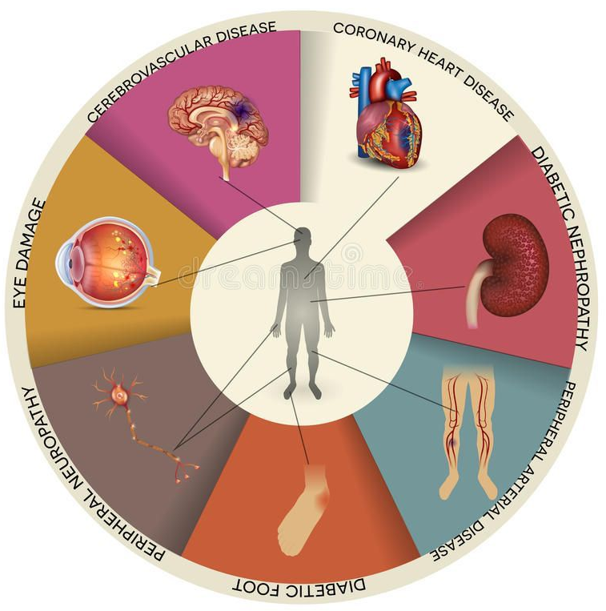
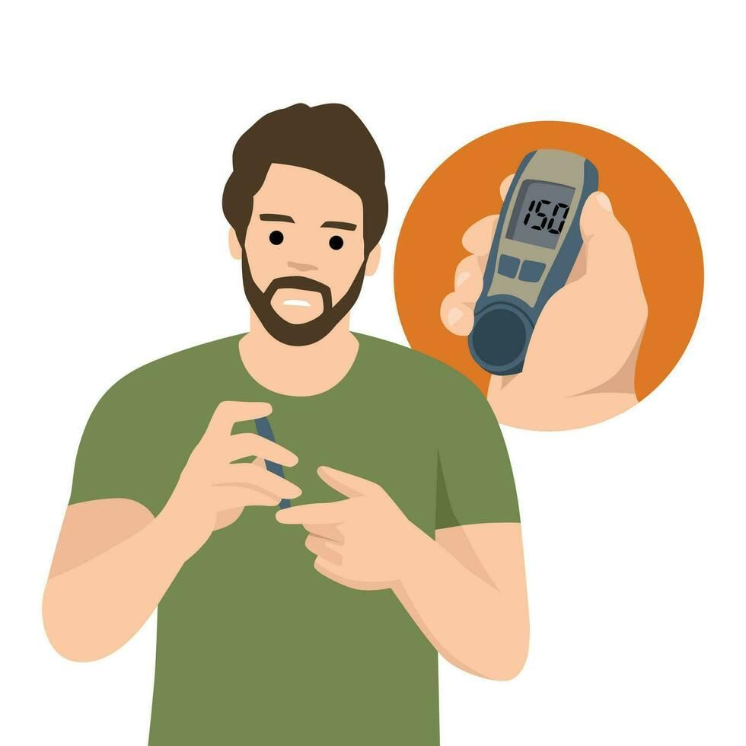
Problem Statement
Diabetes is a common chronic diseases affecting millions worldwide.
Early detection is important to prevent complications.
This project aims to predict whether a person is diabetic based on medical data using machine learning techniques.

Slide 3

Objective
To analyse patient health data
To identify factors affecting diabetes
To build a predictive machine learning model
To assist in early diagnosis

Slide 4

Dataset Description
Dataset contains medical records of patients
Features include glucose level, blood pressure, BMI, age, etc.
Target variable indicates diabetic or non diabetic
Dataset is divided into training and testing sets

Slide 5

Data Preprocessing
Handling missing and zero values
Standardising numerical data
Splitting dataset into training and testing sets
Preparing data for model training

Slide 6
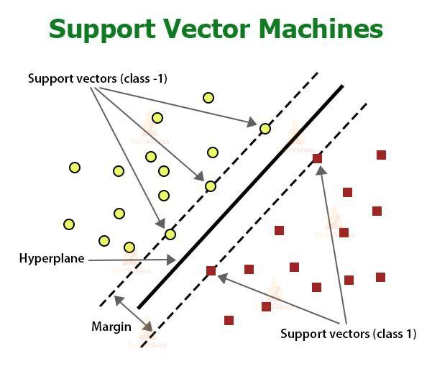
Model Used
Support Vector Machine (SVM) classifier is used
Effective for classification problems
Works well with structured data
Helps in accurate prediction

Slide 7

Model Training
Dataset split into training and testing data
Model trained on training dataset
Learns patterns from input features
Performance evaluated using accuracy score

Slide 8
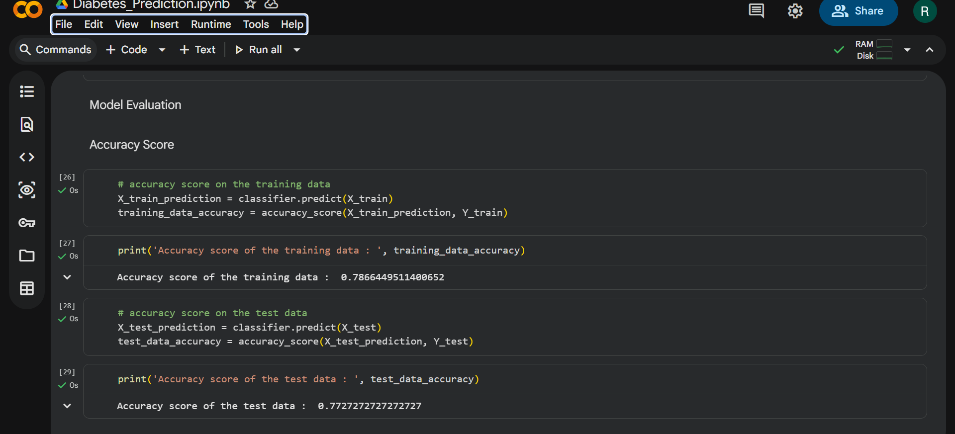
Results
Training Accuracy: ~78%
Testing Accuracy: ~77%
Model performs reasonably well
Provides useful predictions

Slide 9
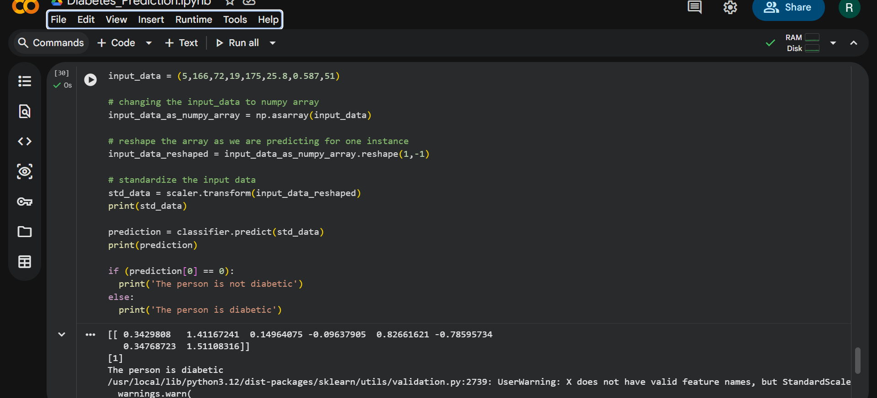
Prediction Output
Model predicts whether a person is diabetic
Example output shows the person is diabetic
Useful for early detection

Slide 10
Conclusion
Machine learning helps in predicting diabetes effectively
Model provides decent accuracy
Can assist in early diagnosis and treatment
Useful for healthcare systems

Slide 11
Future Scope
Improve accuracy using advanced models
Use larger datasets
Build real time applications
Integrate with healthcare systems

Slide 12
Thank You
Project Submitted By:
Rhyma Jilani
jilanirhyma05@gmail.com

